Slide 1
Status of Medical Physics Service and Education in Nepal
Matrika Prasad Adhikari
M.Sc.(TU), Dip.R.P.(BARC, India)
Medical Physicist

Slide 2
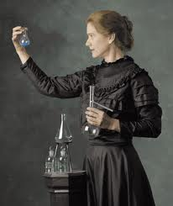
Marie Curie (1867-1934)

Slide 3
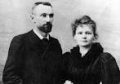
Marie and Pierre Curie

Slide 4
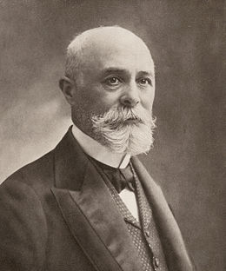
Antoine Henri Becquerel(1852-1908)

Slide 5
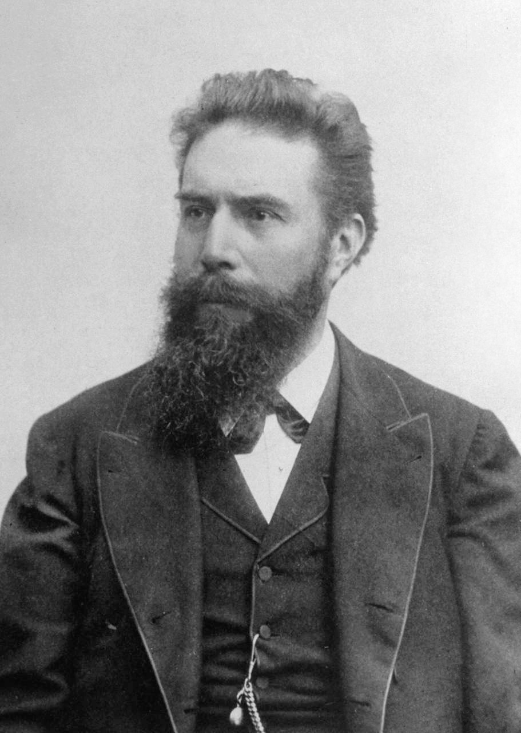
Prof. Dr. Wilhelm Conrad Roentgen (1845-1923)

Slide 6
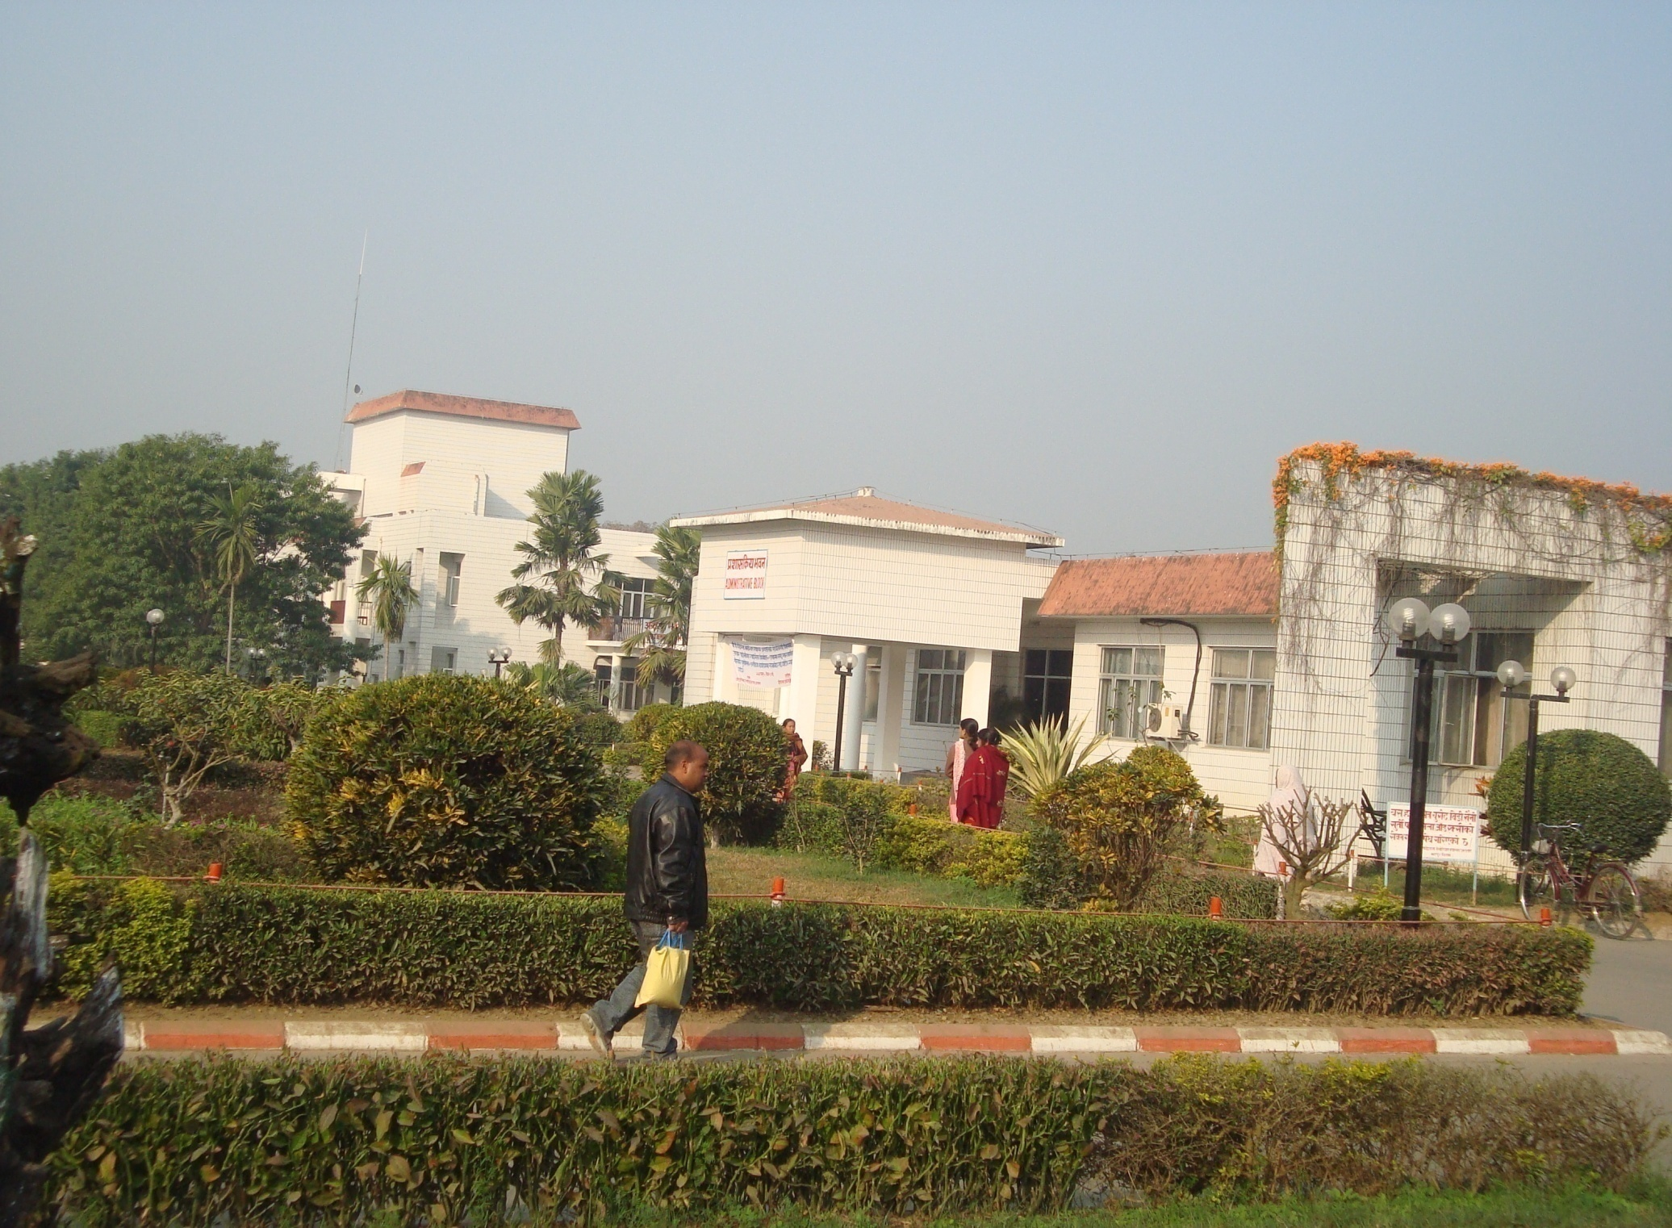
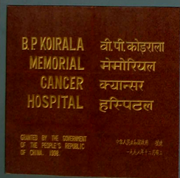

Slide 7
Introduction
Physics has contributed a lot in medicine
Electrocardiography
Electroencephalography
Stethoscopes
Electron microscope
ENT equipments
lenses
X-rays, Ultrasound, Magnetic Resonance Imaging
Radiotherapy, nano-technology and chemotherapy
Laser therapy and laser surgery
Nuclear-medicine

Slide 8
Medical Physicist are mainly involved in
Radiation oncology.
Radio diagnosis and Imaging.
Nuclear medicine (diagnostic and therapeutic).

Slide 9
Responsibilities
Oncology Physicist
Diagnostic Physicist
Radiation safety officer
Academician &researcher

Slide 10
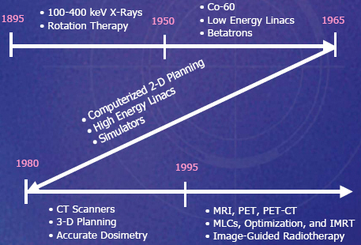
Radiation in medicine, timeline

Slide 11
Radiotherapy is a field where Physicist has a leading and important role
Planning of 3D Conformal Radiotherapy, Intensity Modulated Radiotherapy (IMRT).
Calculation of treatment time and patient dose.
Quality assurance of Linear accelerator,Co-60, Brachy therapy,Simulator,CT and X-ray machine.
Brachy therapy treatment planning and treatment execution.
Dosimetry of photon, electron and beam data generation.
Room Design of Radiotherapy Radio-diagnosis and Nuclear medicine.
Commissioning of Equipments that involve ionizing radiation.
Implementation of radiation Protection guidelines accepted by competent authority

Slide 12
B.P. Koirala memorial Cancer Hospital, Bharatpur
Cobalt-60 (1)
Linac 600C/D (1)
Linac2300C/D (1)
Simulator (2)
HDR- Brachytherapy (1)
Eclipse treatment planning system with ARIA 10 networking
Deep Therapy (not functioning)

Slide 13
Human Resources
Radiation Oncologists – 8
Medical Physicists – 4
Radiotherapy Technologist / Technician – 4+ 8
Nursing Staff – 2
Other Supporting Staff

Slide 14
Bhakatpur Cancer Care Center
Cobalt-60 (1)

Slide 15
National Academy of Medical Sciences, Bir Hospital, Kathmandu
Cobalt-60 (1)

Slide 16
Manipal Medical College, Pokhara
Cobalt-60 (1) not functioning
Linac (1)
Simulator (1)

Slide 17
RADIATION SOURCES IN BPKMCH
SEALED CHECK SOURCE
ACTIVITY
Piece
T1/2
Strontium-90 beta 540 Kev
33.3MBq
1
28.7Year
Strontium-90 cylindrical
33.3MBq
1
28.7Year
137 Cs 662Kev
0.37MBq
5
30Year
Cobalt –60 (1.25 Mev )EXRT
12000Ci
1
5.26 Year
Iradium-192 (380Kev)
10-11 Ci
1
74 Days
*Cobalt –60
1000 Ci
1
5.26Year
*put in garbage room inside source transport container cemented @ 5 cm. 0.5 μSv/hr ( safe limit )but is a potential orphan source can lead to health hazard.

Slide 18
Treatment Planning

Slide 19
Treatment planning in Eclipse System
The CT slices are imported to the Eclipse planning System
DRRs are reconstructed
Gives Transverse, Frontal and Sagittal Images
Contouring:
Volumes are given for: Body, Bones, GTV,CTV, and Critical Structures .
Then treatment planning is done by setting beams from various angles and with other planning parameter

Slide 20
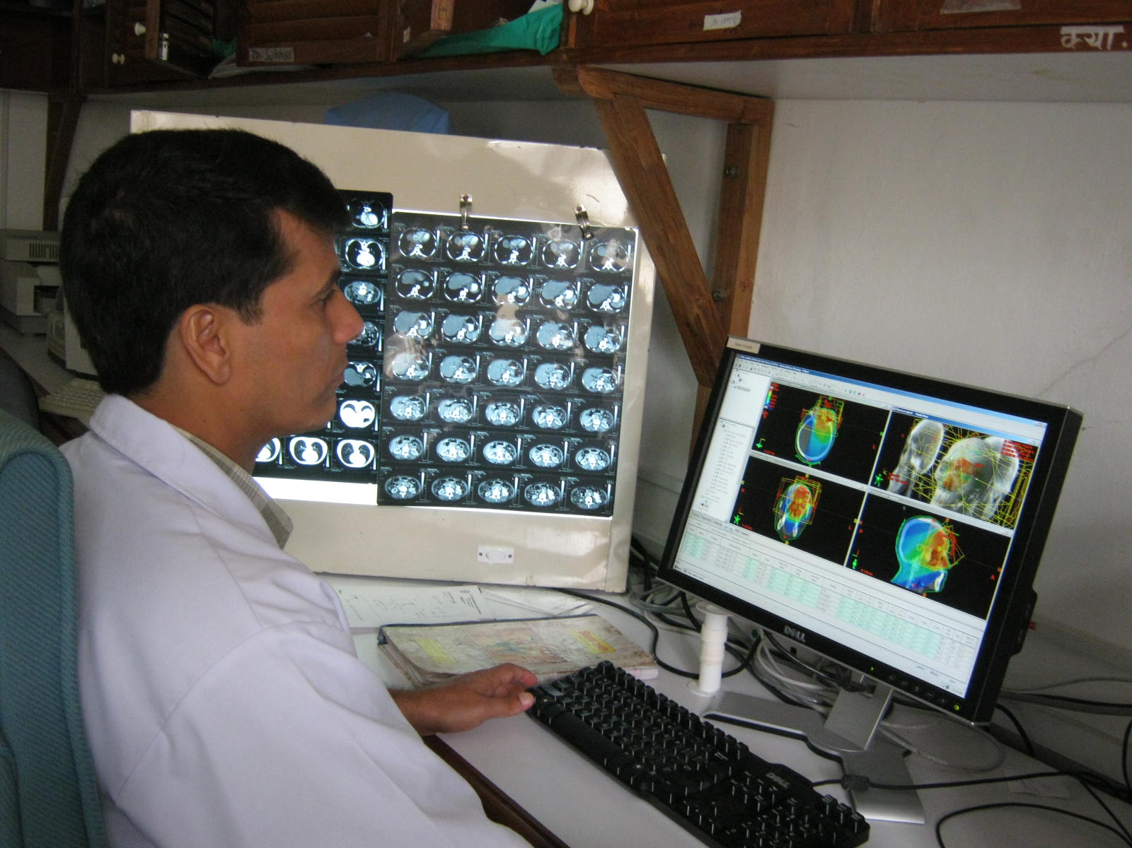

Slide 21
CT slices are imported to Planning system

Slide 22
Body, Bones, GTV, CTV, PTV and other critical organs are contoured

Slide 23
Isodose Lines

Slide 25
Field Setup

Slide 26
Beams Eye View and Sparing of lens, Brain stem, and retina in AP Field

Slide 27
MLC IN LINAC HEAD

Slide 28
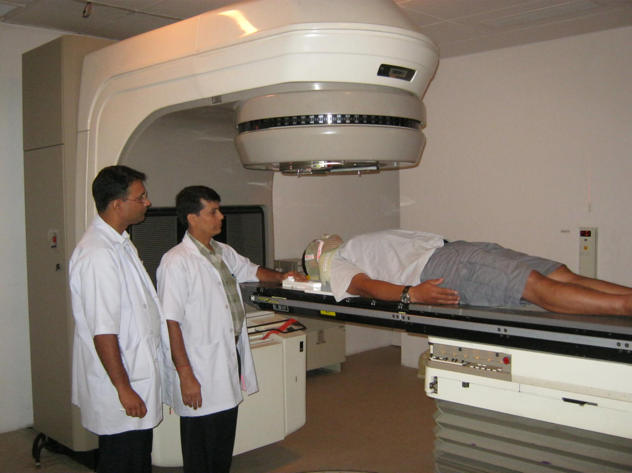
Medical Physicist With Doctor in patient Set Up

Slide 29
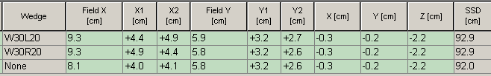
Treatment
Patient is positioned in treatment Machine
Patient Position is reproduced in machine as that of CT
With the help of reference marker the beam center is set to the tumor center
Very important for accurate treatment

Slide 30
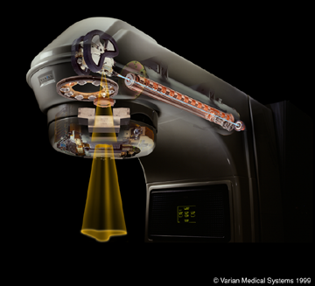
Various Components of Linear Accelerator

Slide 31
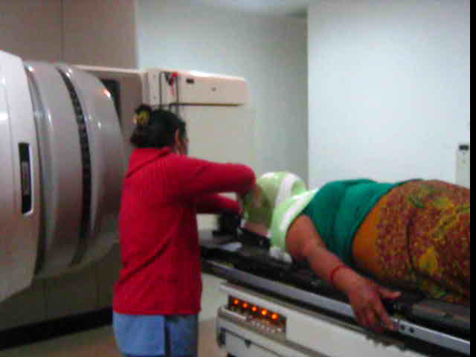
Positioning in Intensity Modulated Radiotherapy (IMRT) v

Slide 32
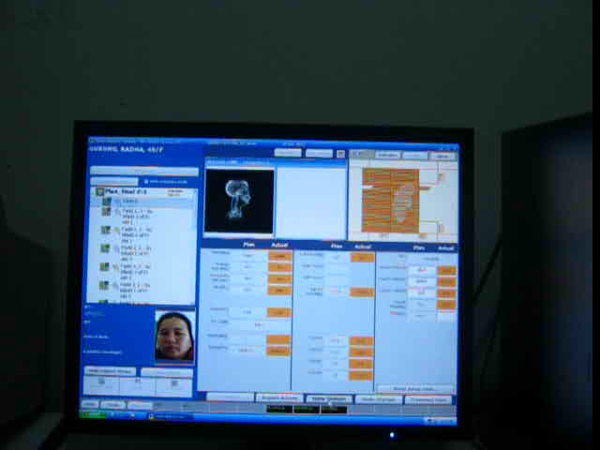
IMRT treatment window in control console v

Slide 33
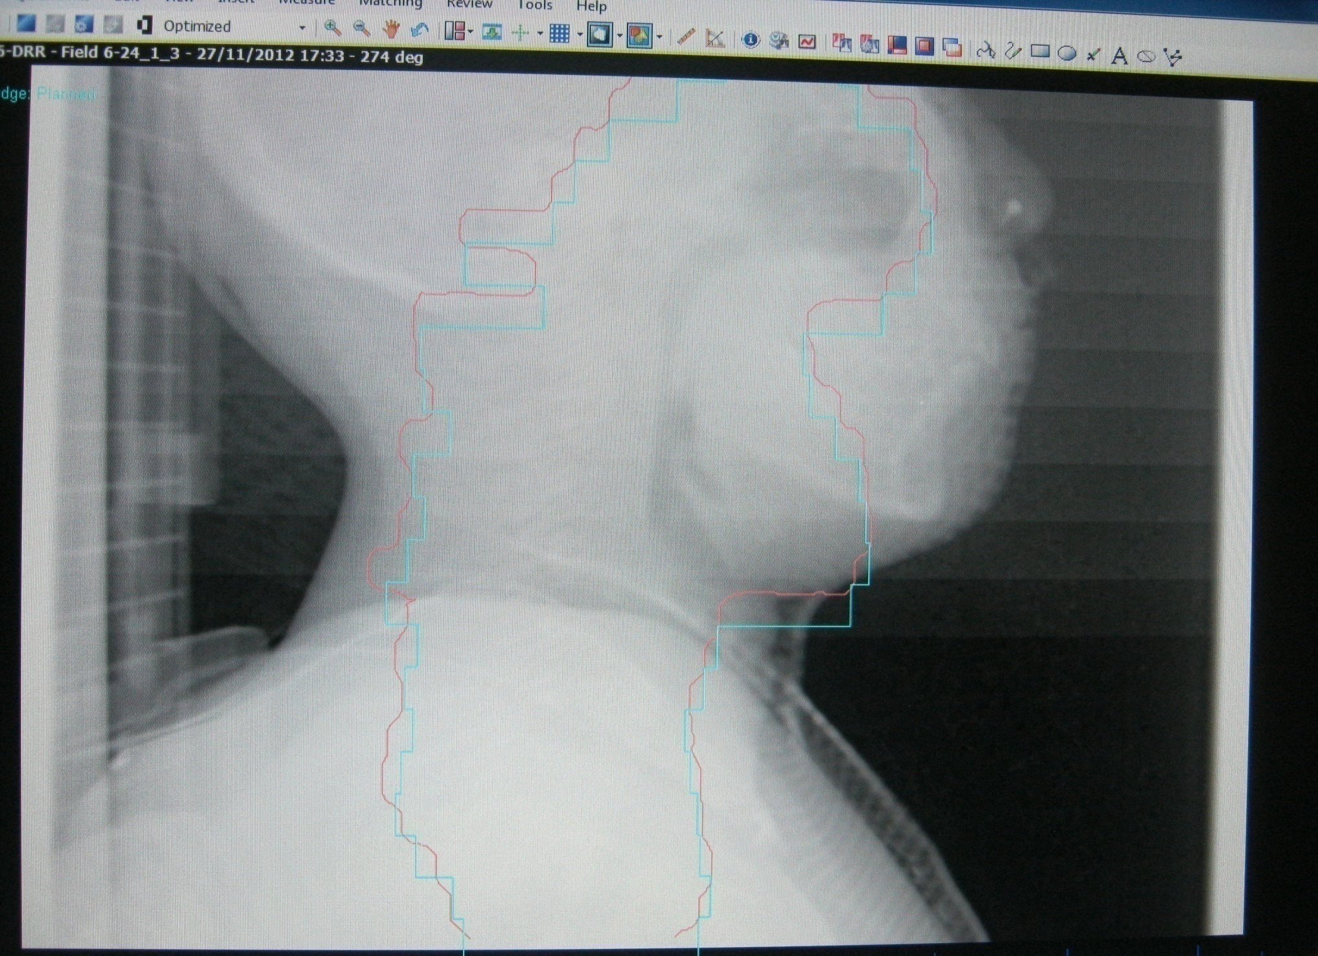
Mismatch of DRR and Set up

Slide 34
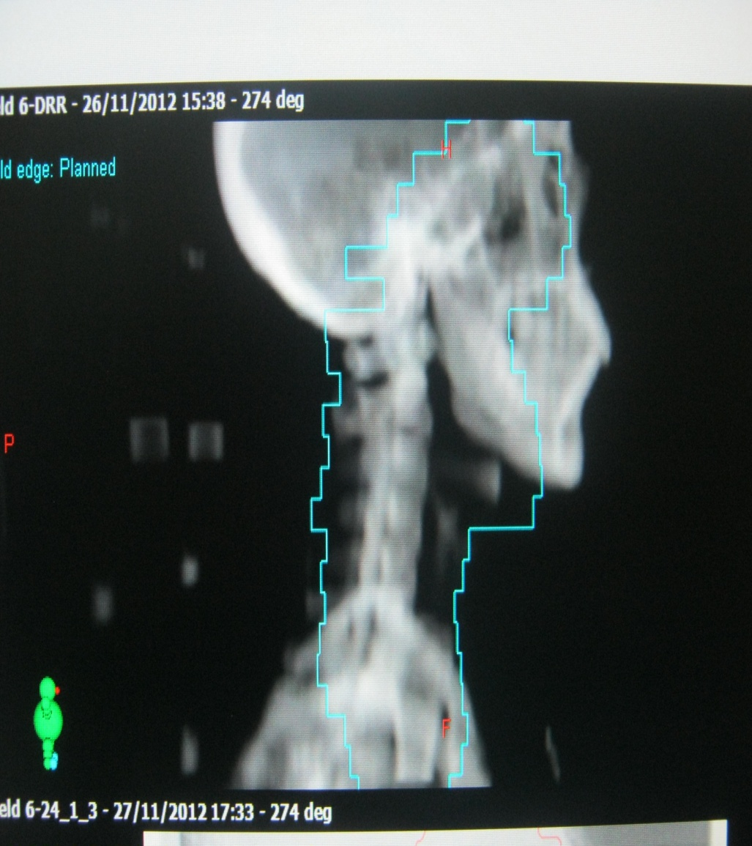
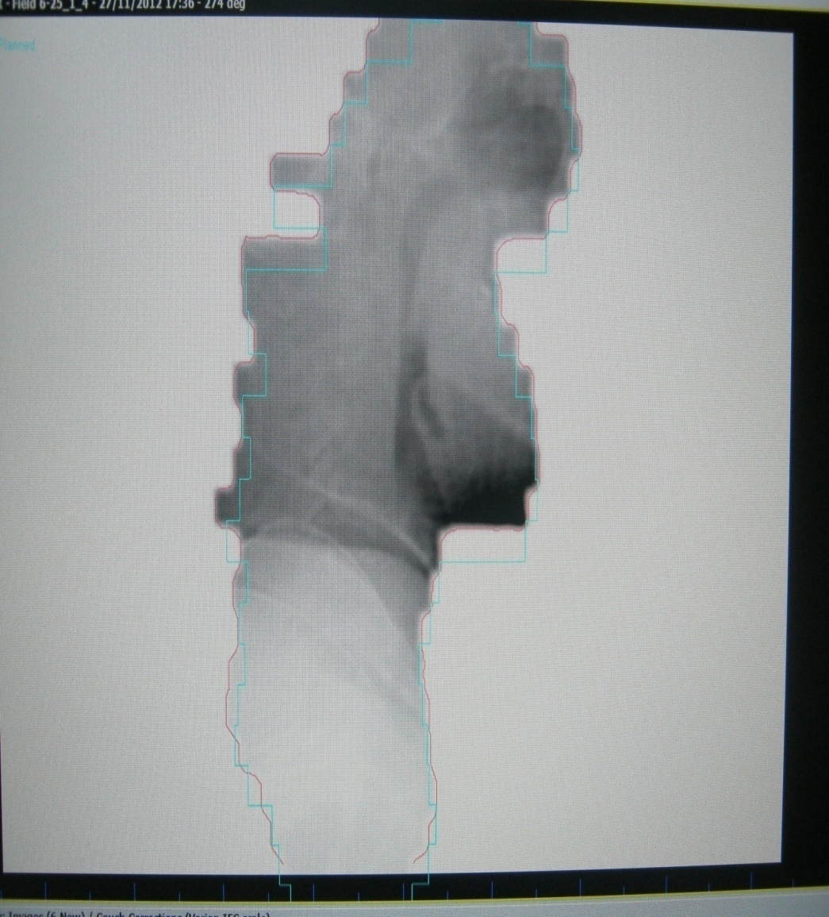
DRR and mismatch check

Slide 35
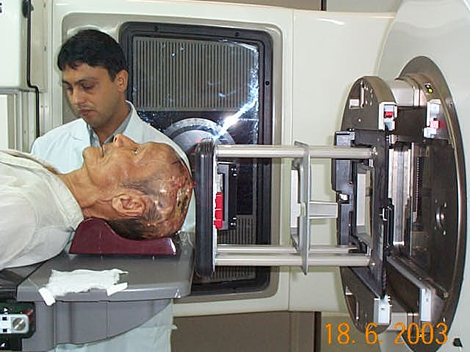
PT. Setup 2300 CD Electron, G90 couch 270

Slide 36
Quality assurance
&
Dosimetry

Slide 37
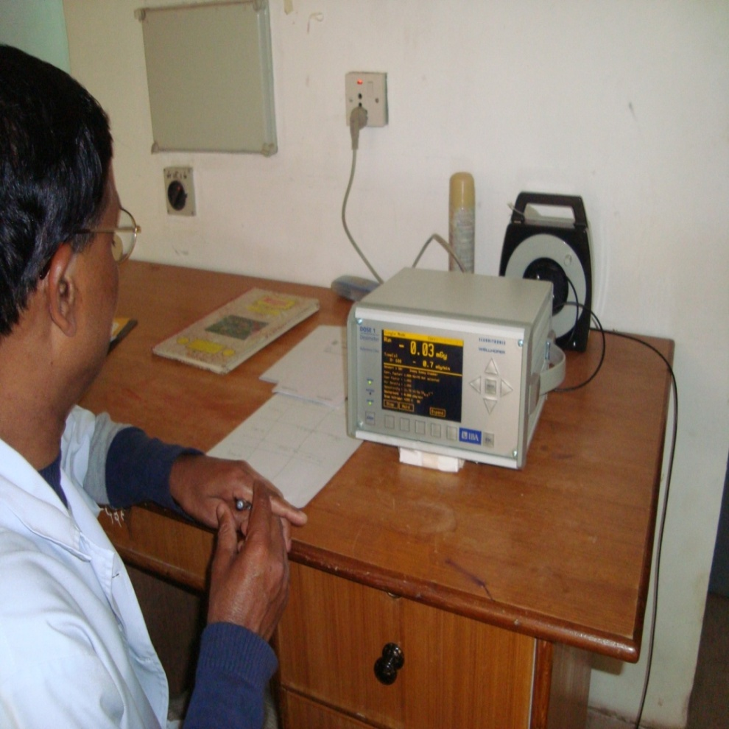
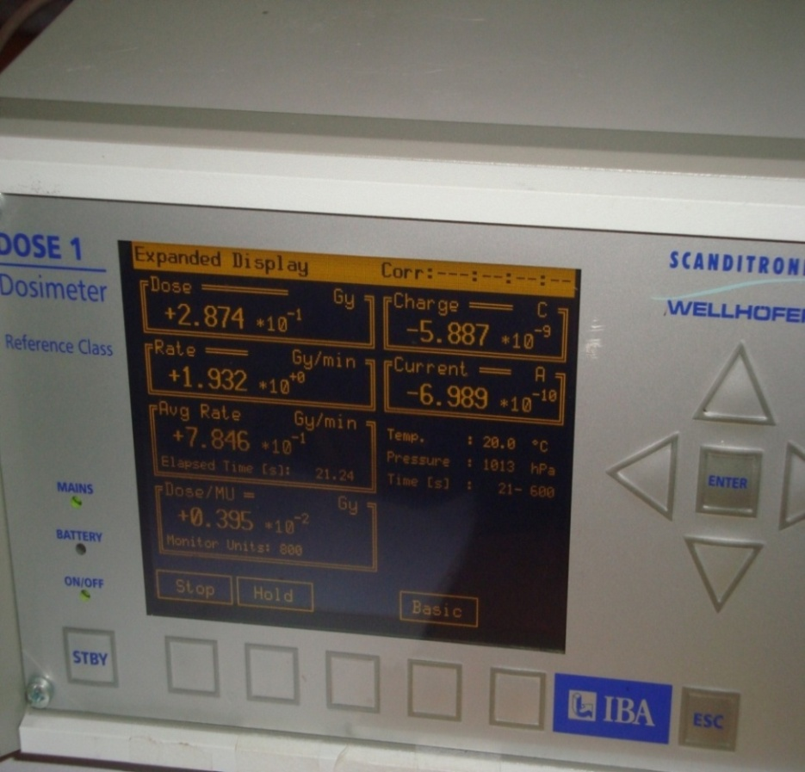
DOSE 1 ELECTROMETER

Slide 38
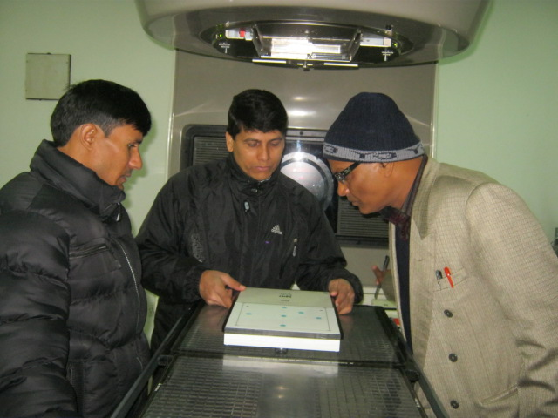
Daily Quality Assurance using Solid State detector
Quality assurance of Linear accelerator

Slide 39
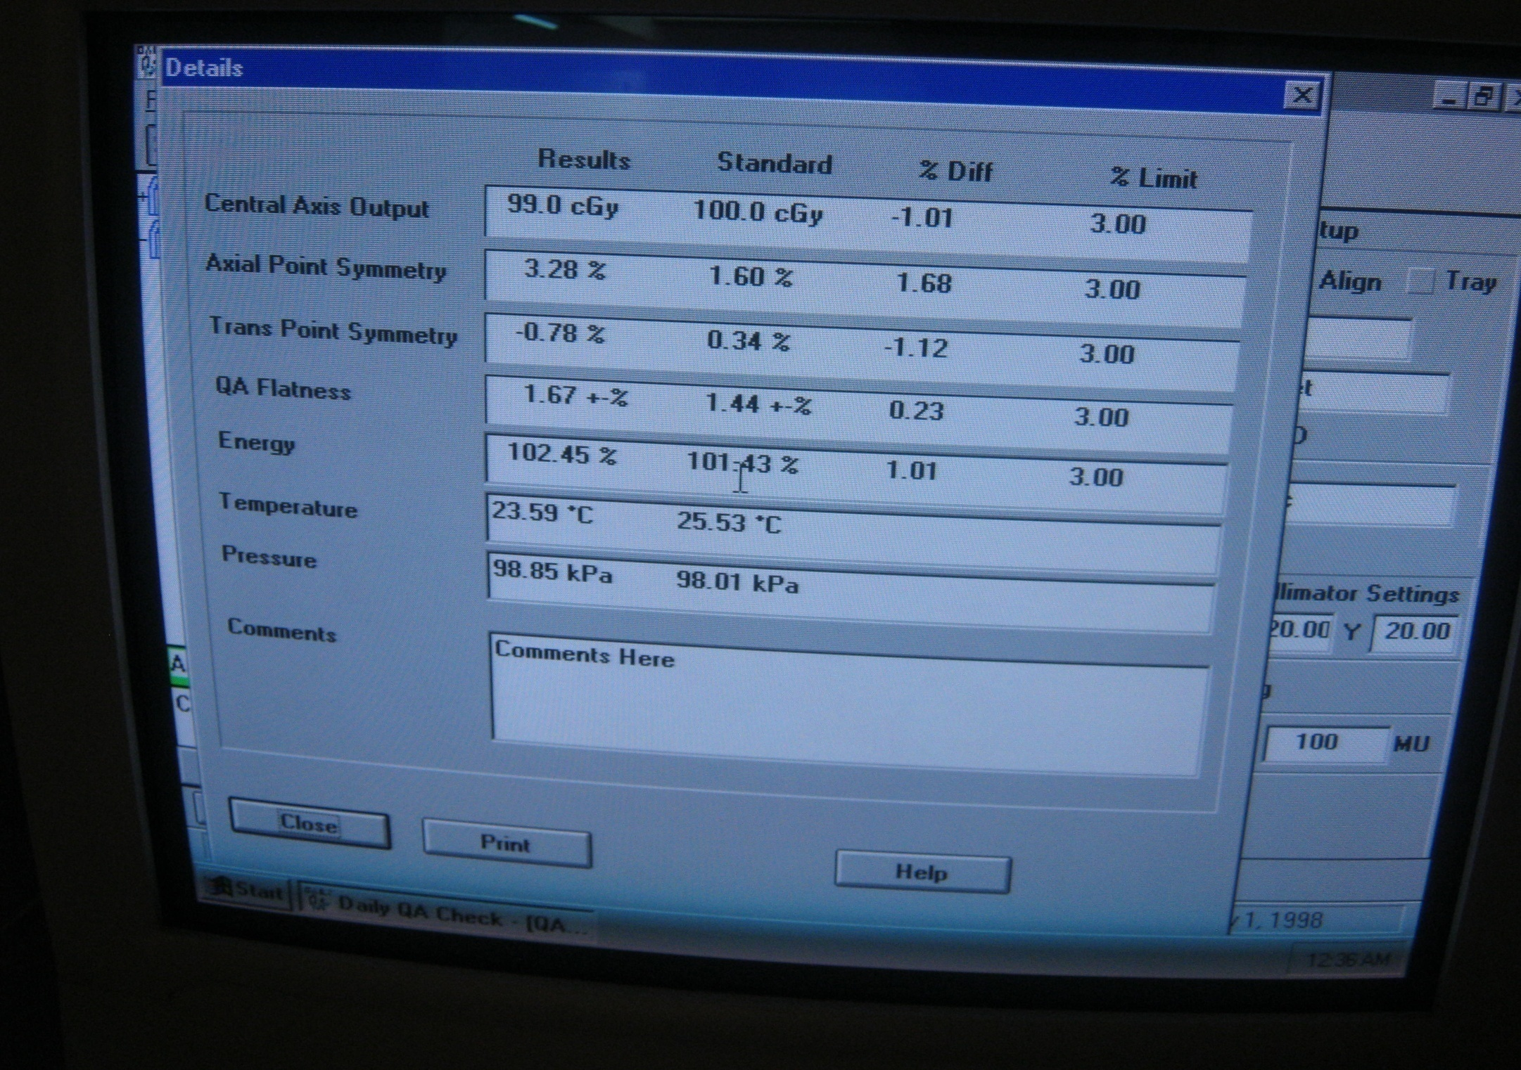

Slide 40
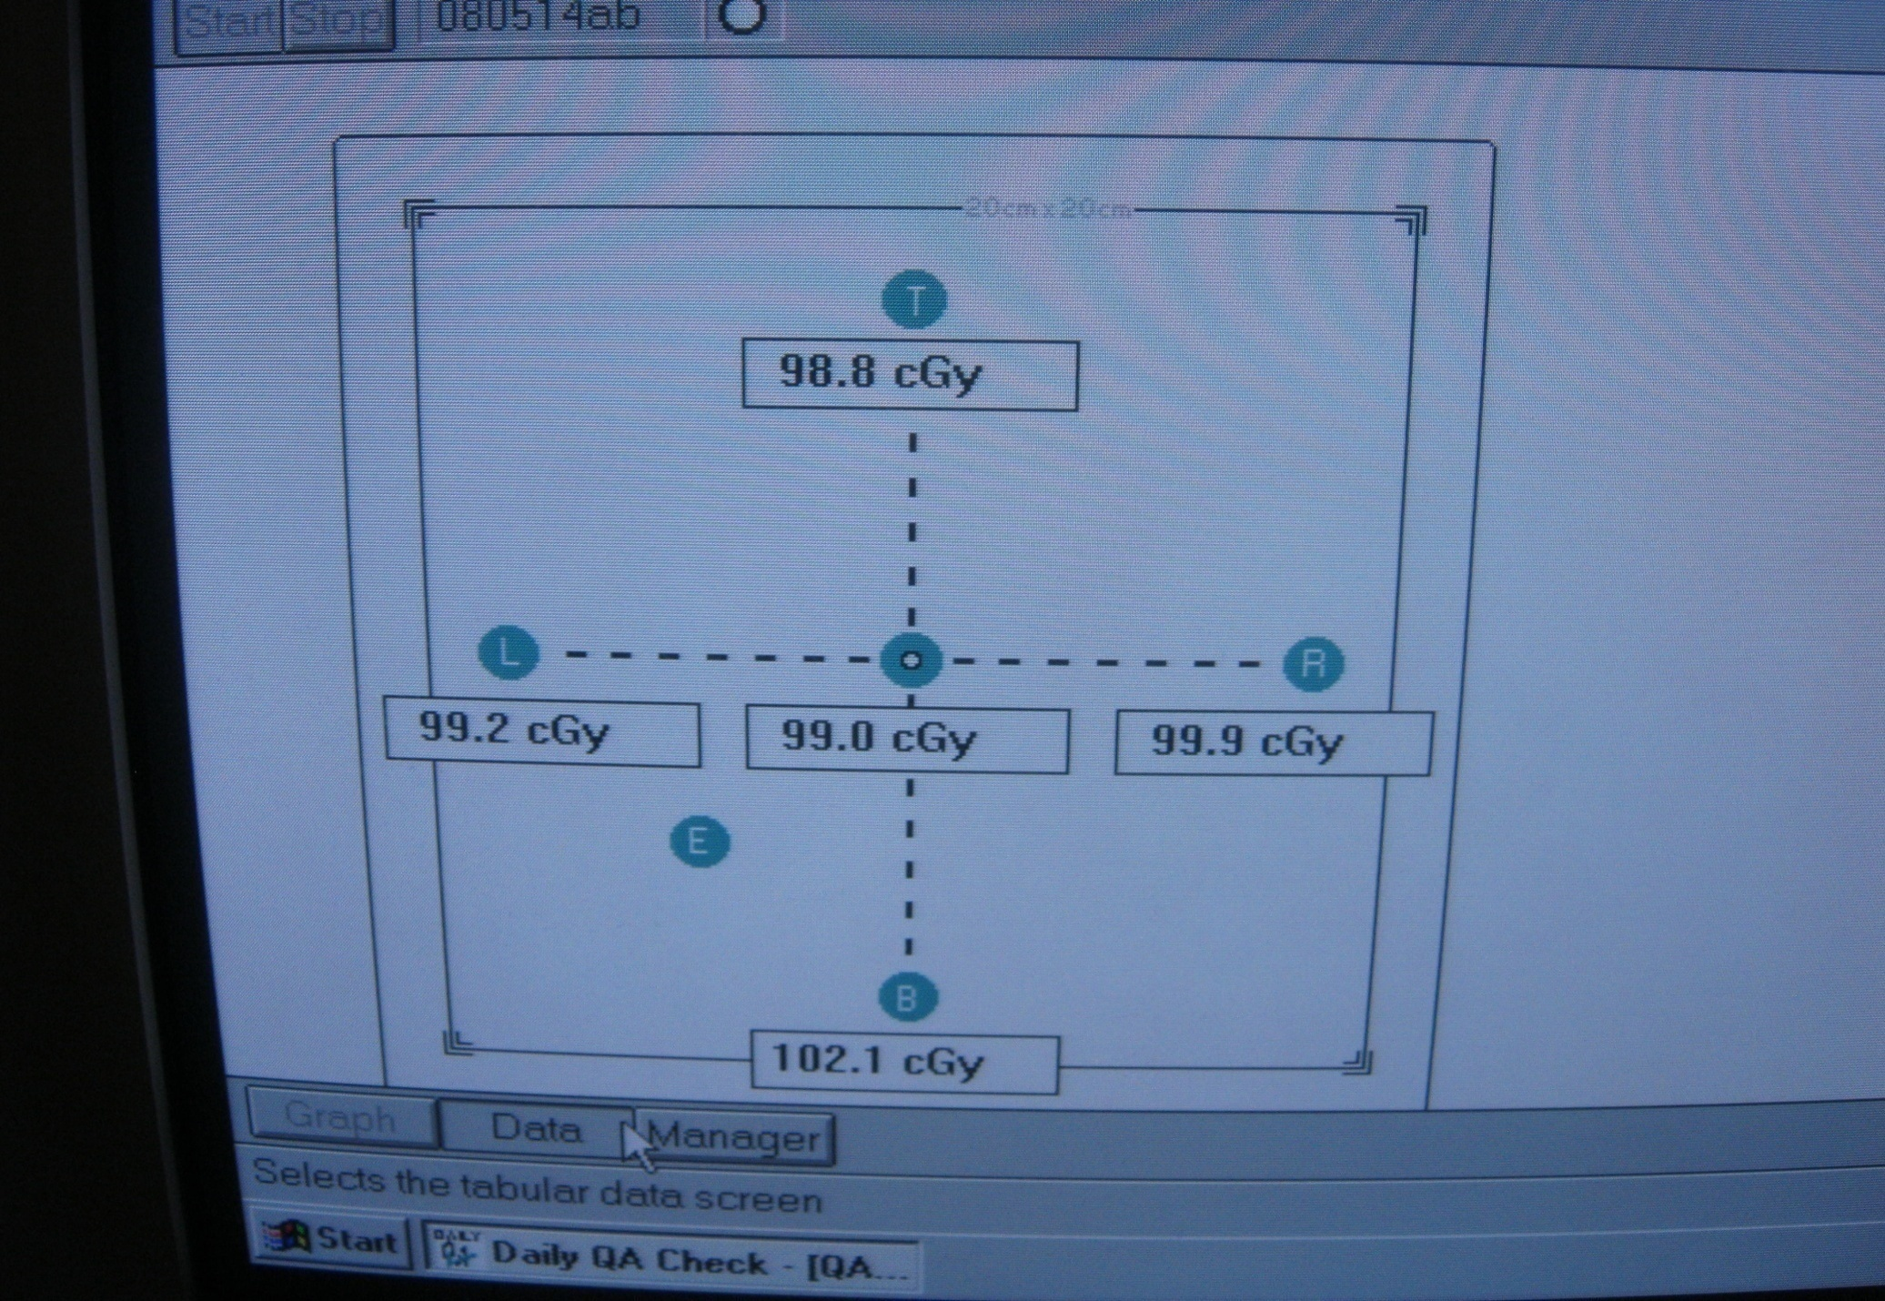
100 MU reading Data

Slide 41
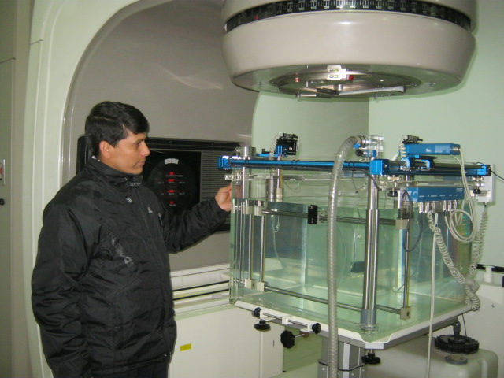
Collection of 6MV and 20 MV Photon data with the help of Blue phantom

Slide 42
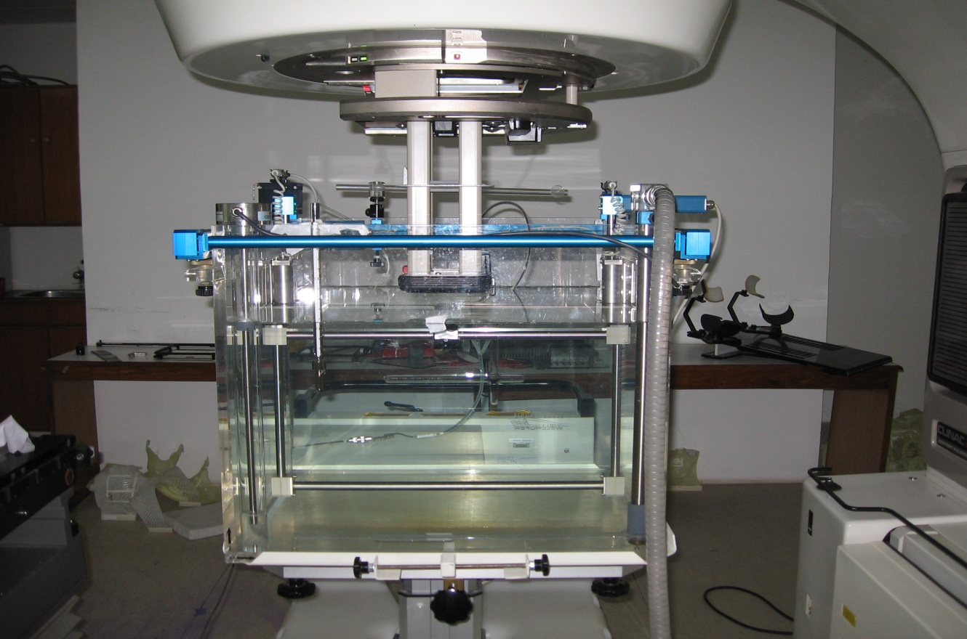
Electron absolute dose measurements in water ppc-05,center at Zref.

Slide 43
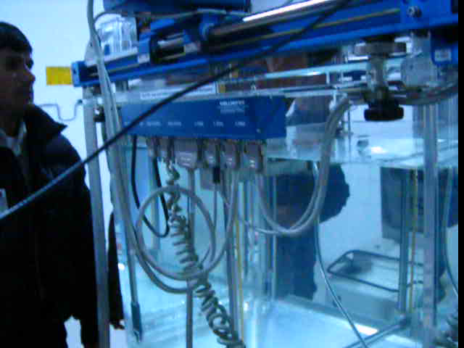
Blue phantom v

Slide 44
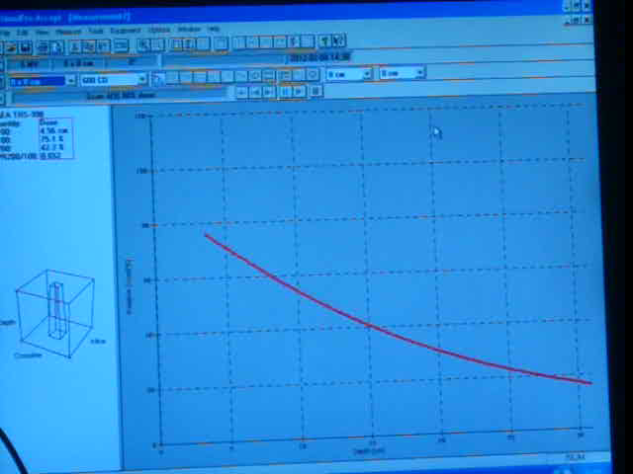
Percent Depth Dose Measurement

Slide 45
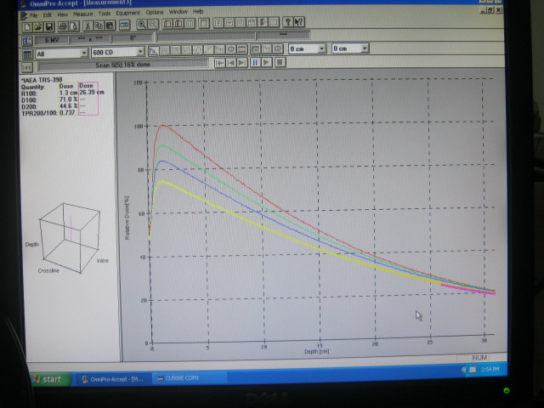

Slide 46
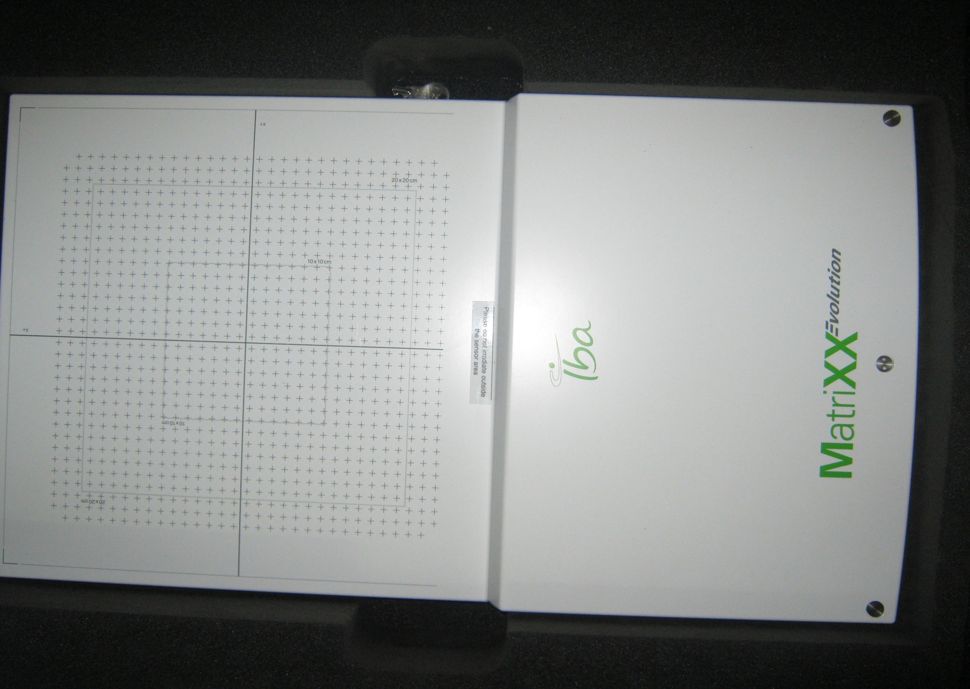

Slide 47
Brachytherapy
Treatment of cancer by keeping the radioactive source near to the tumor.
High Dose Rate, Remote after loading With Iridium 192 source.
Solid single radioisotope of 5mm in length and 0.348 mm diameter, gamma 0.380 Mev,
T1/2 =74 Days replacement in 4 months
8 Gy Dose per Fraction and One week intervals between the applications.

Slide 48
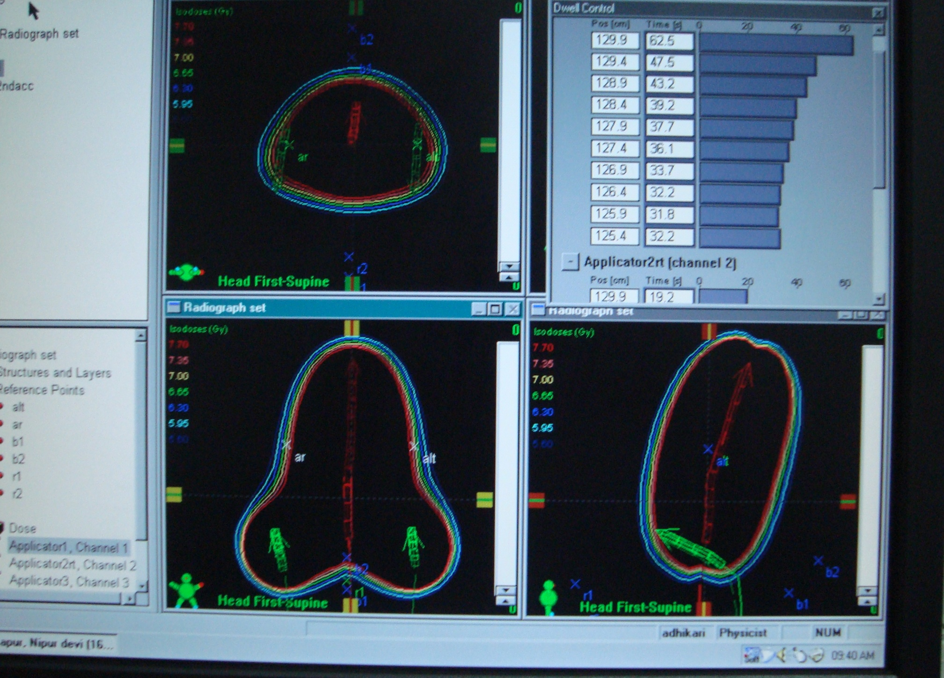
Planning

Slide 49
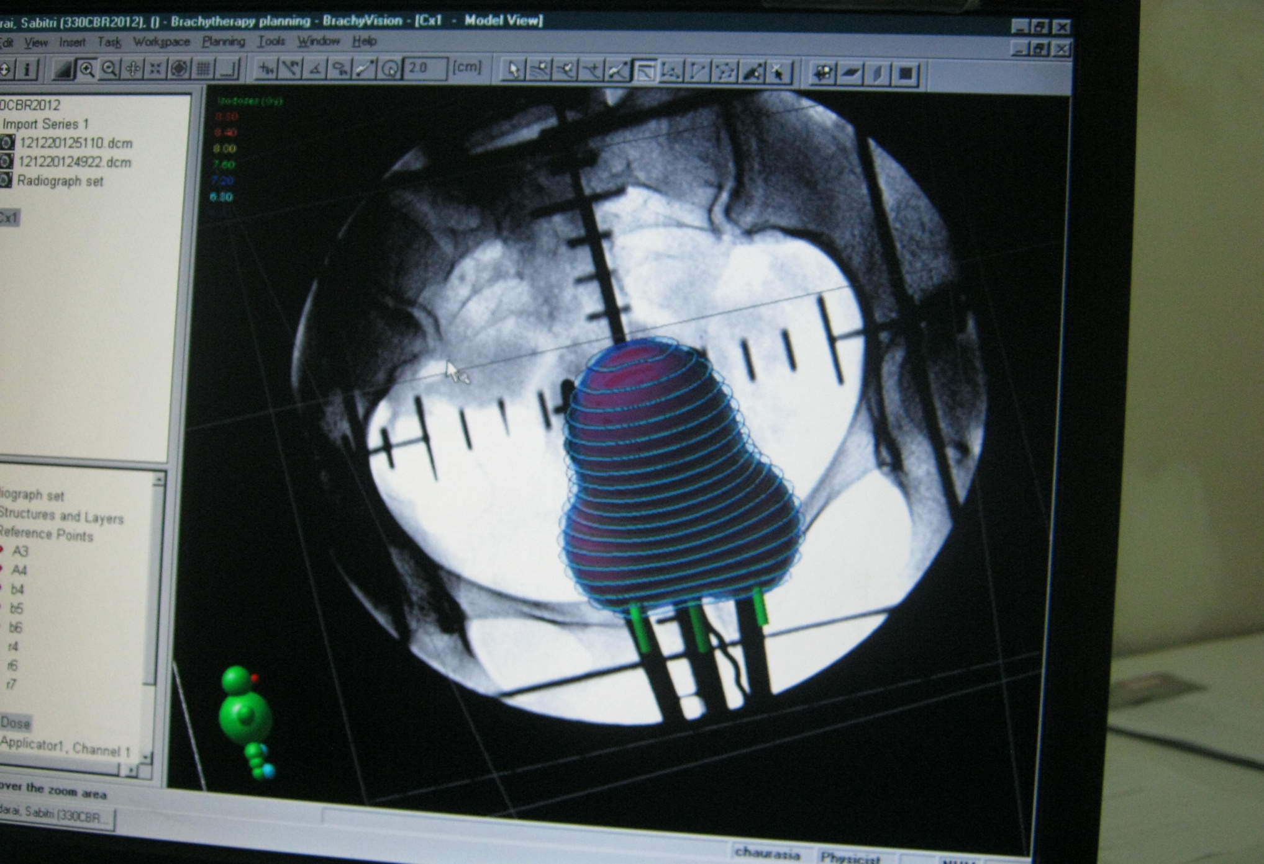
3D Dose distribution

Slide 50
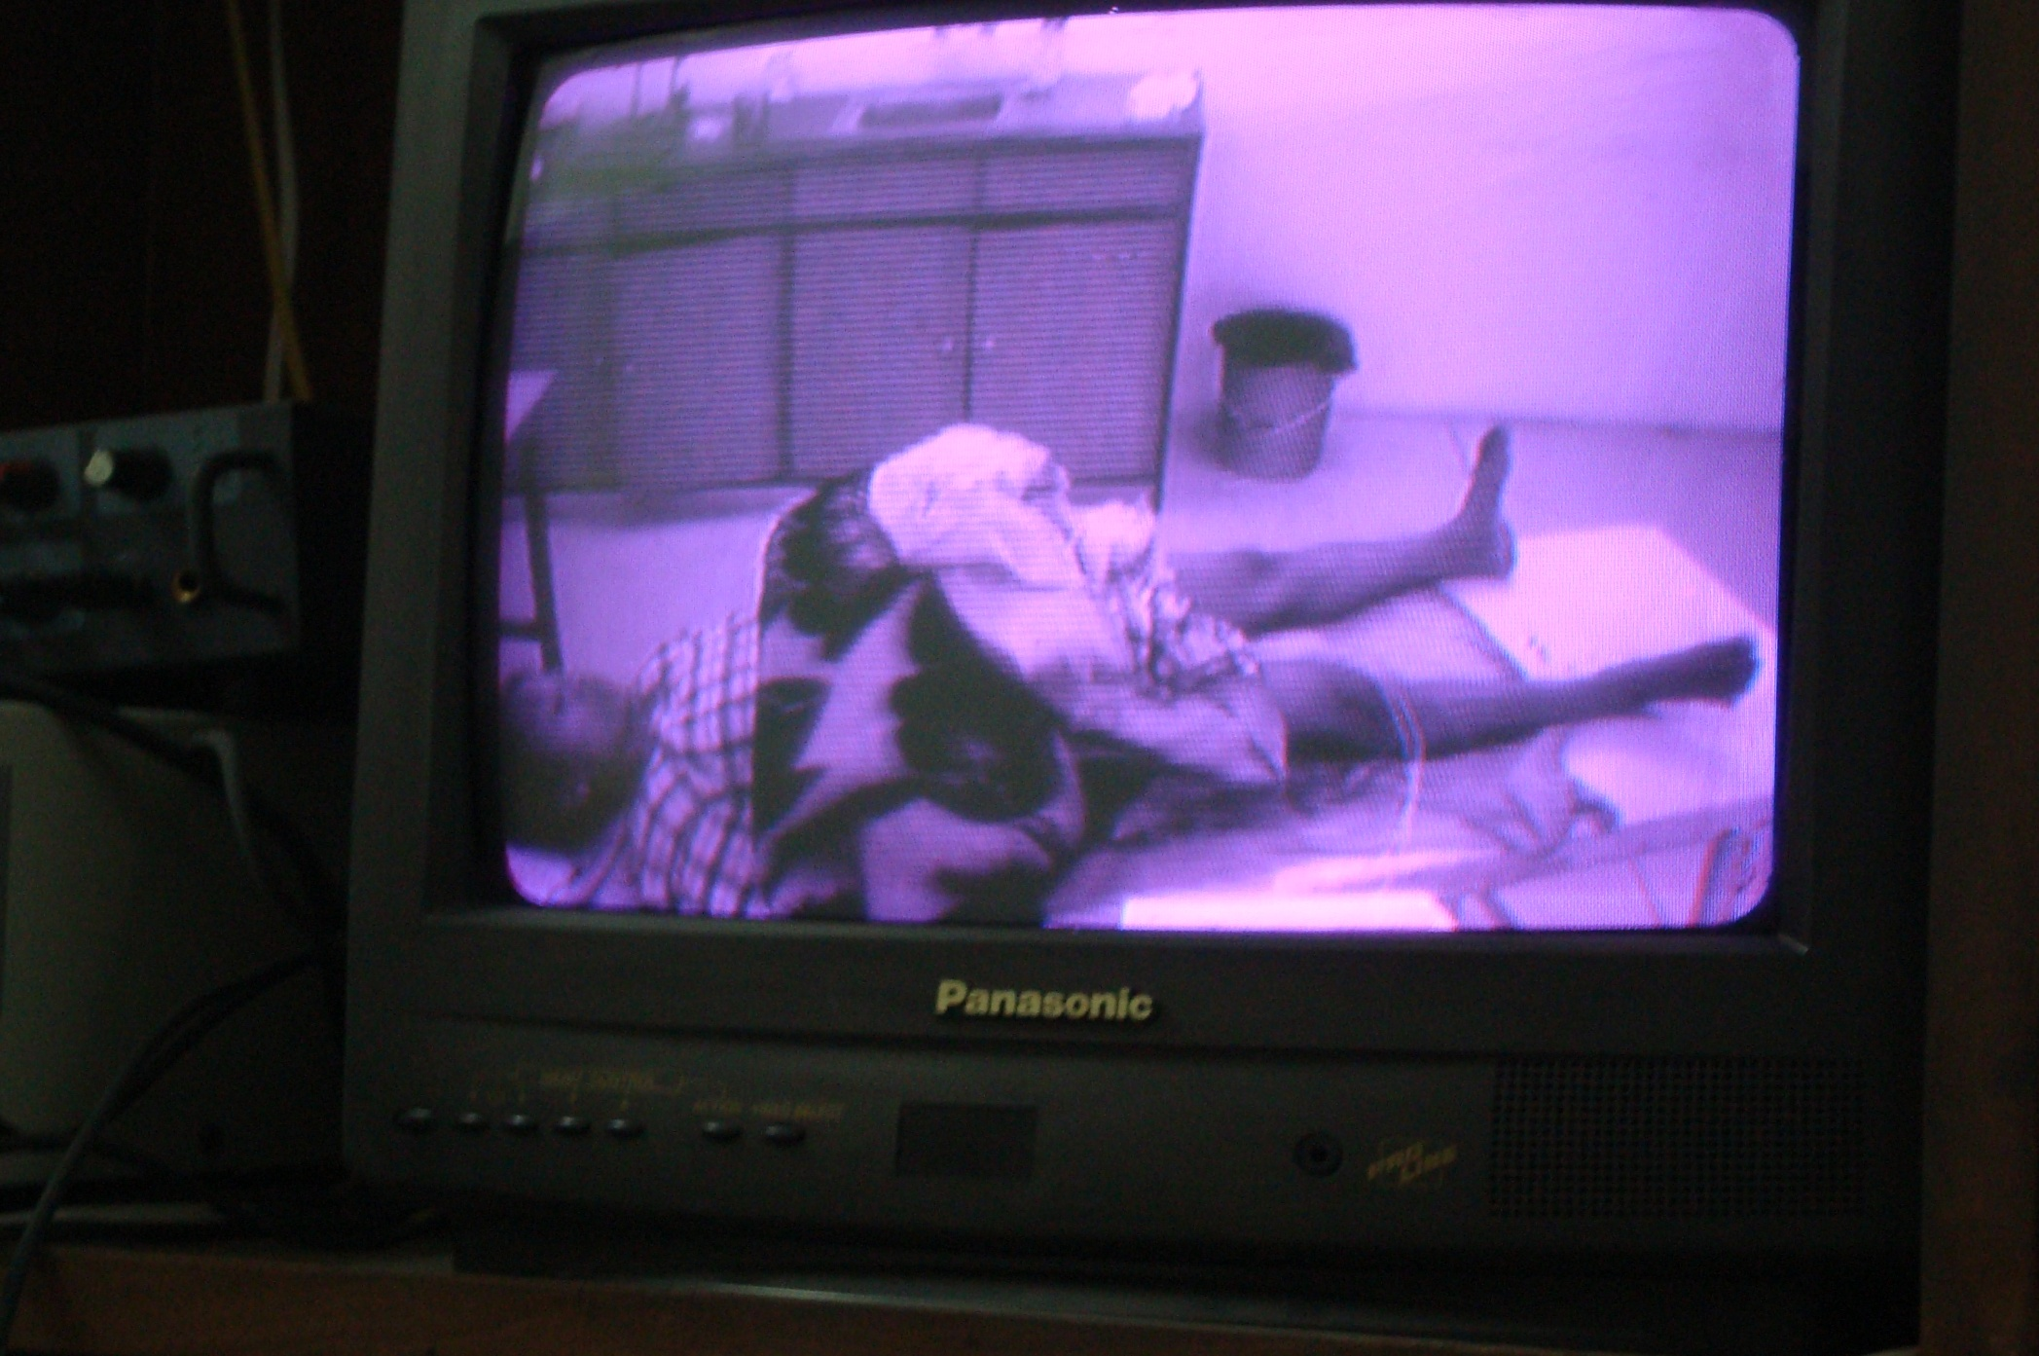
Visual During treatment

Slide 51
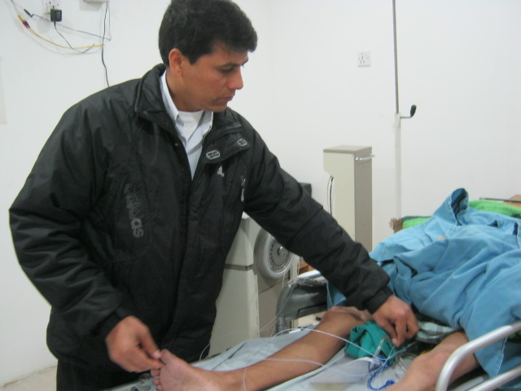
Application of Catheter during treatment of cervix Cancer

Slide 52
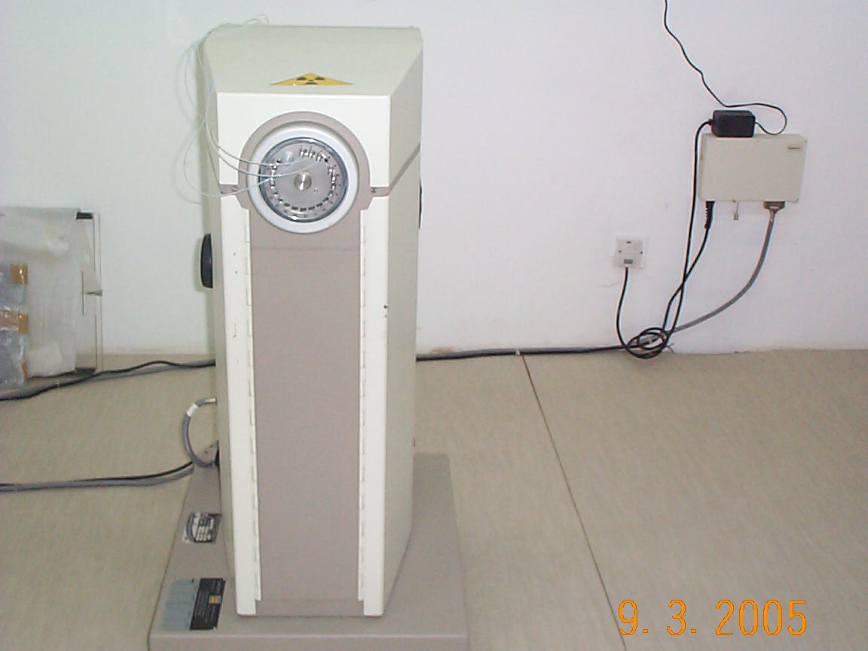

Slide 53
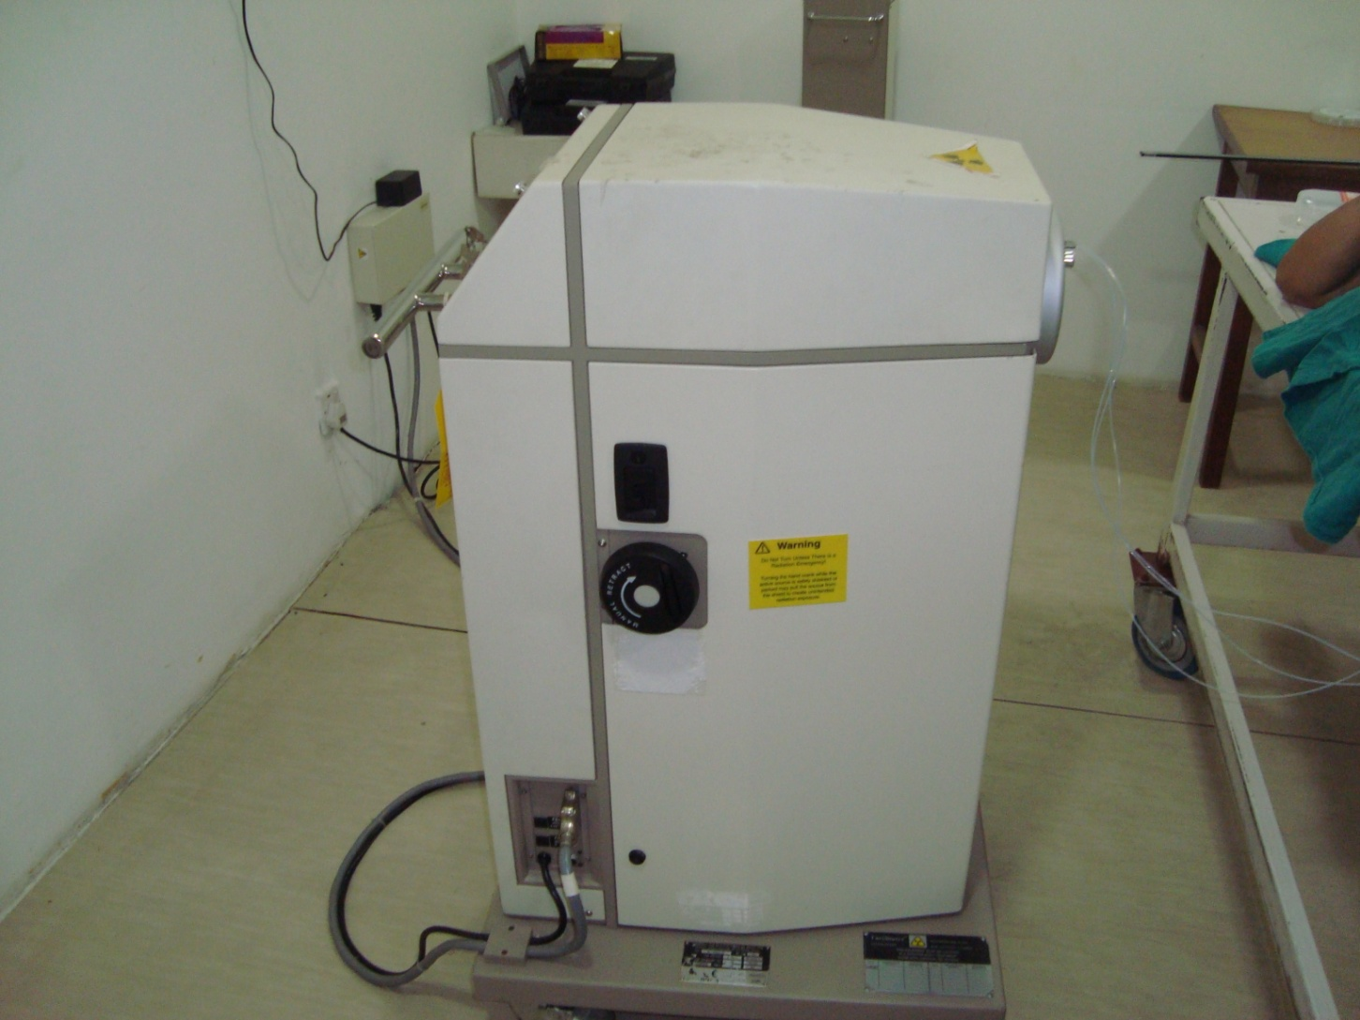
HDR BRACHYTHERAPY MACHINE

Slide 54
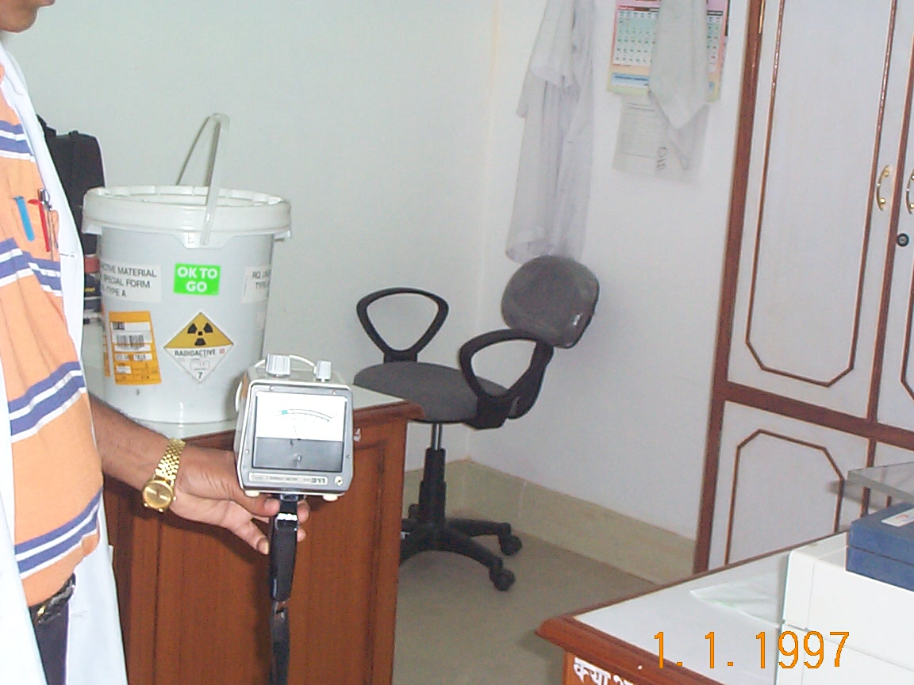
New Ir 192 source arrival survey, documentation & T.I. value measurement

Slide 55
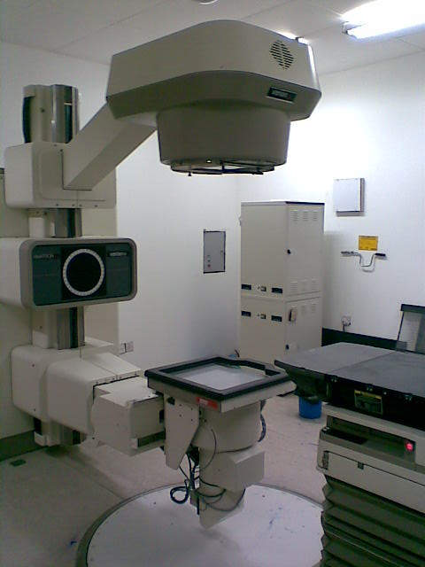
Simulator

Slide 56
Patient Conventional Simulation
Visualize the tumor area in fluoroscopic device
Put the field size and center on the patient body or immobilizing device.

Slide 57
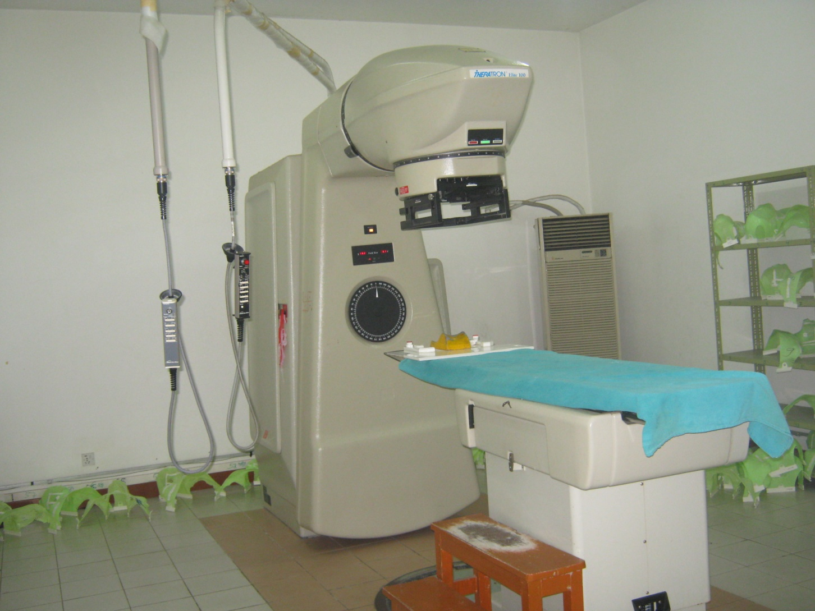
Co -60 teletherapy machine

Slide 58
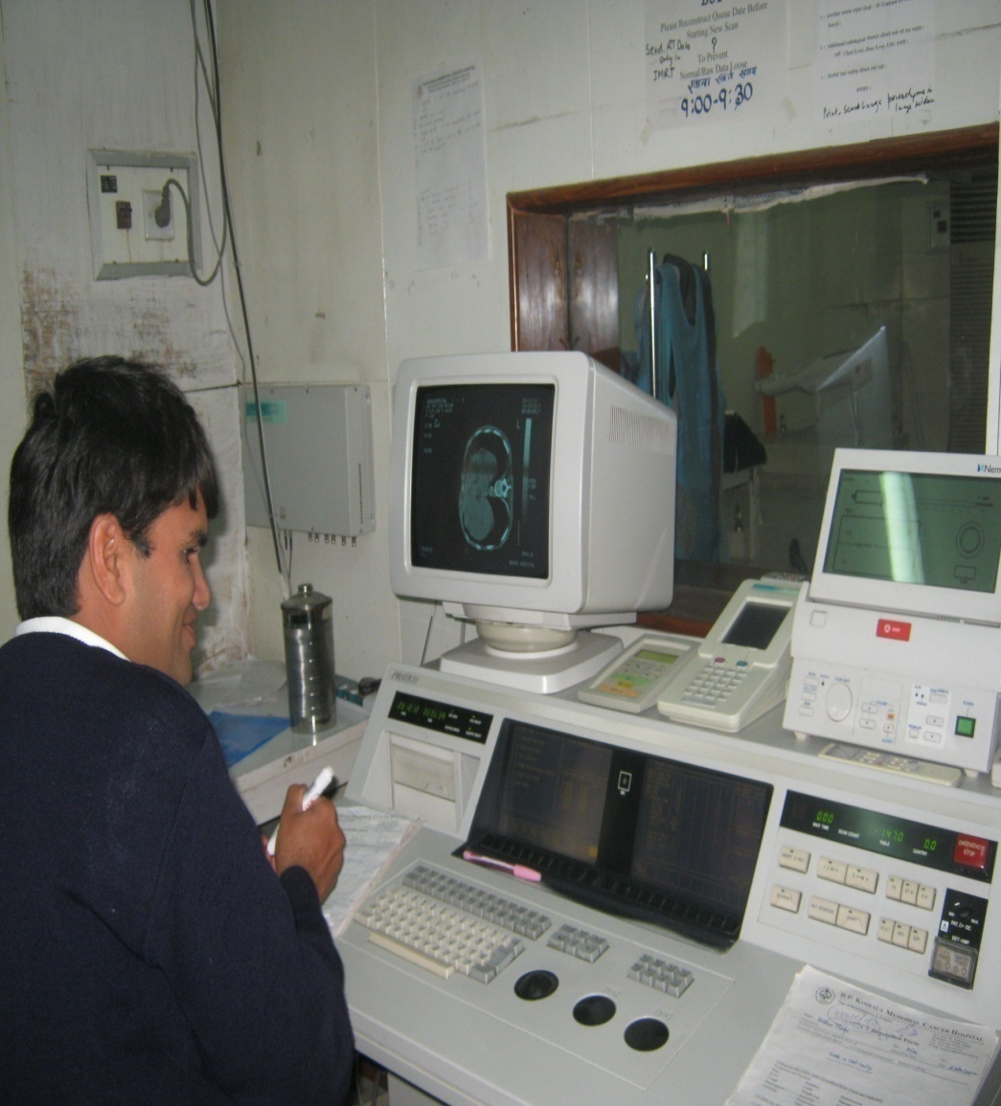
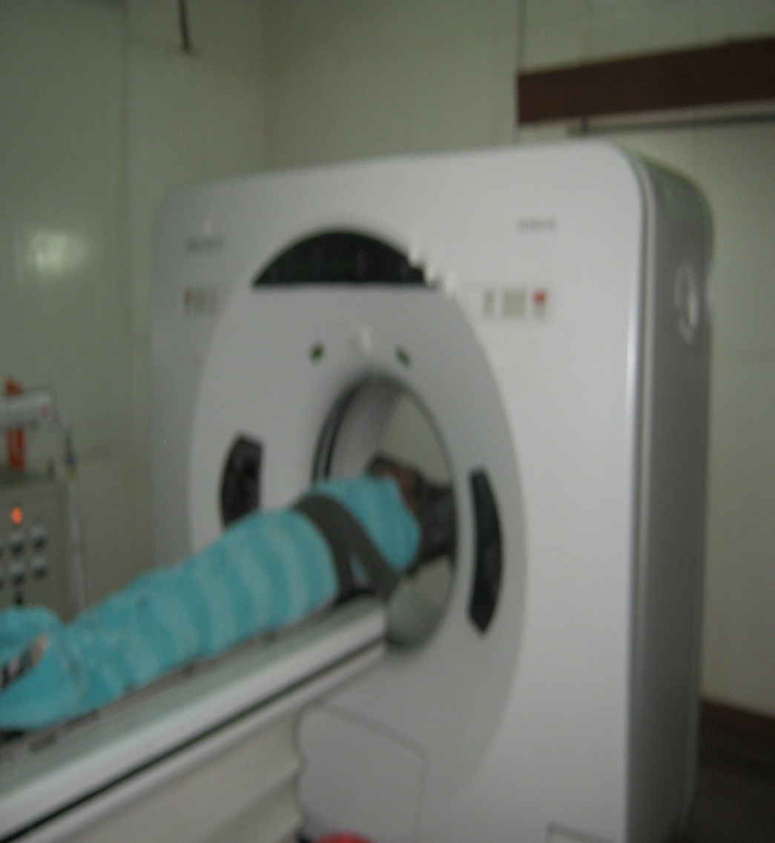
Control console and patient in C T Scan

Slide 59
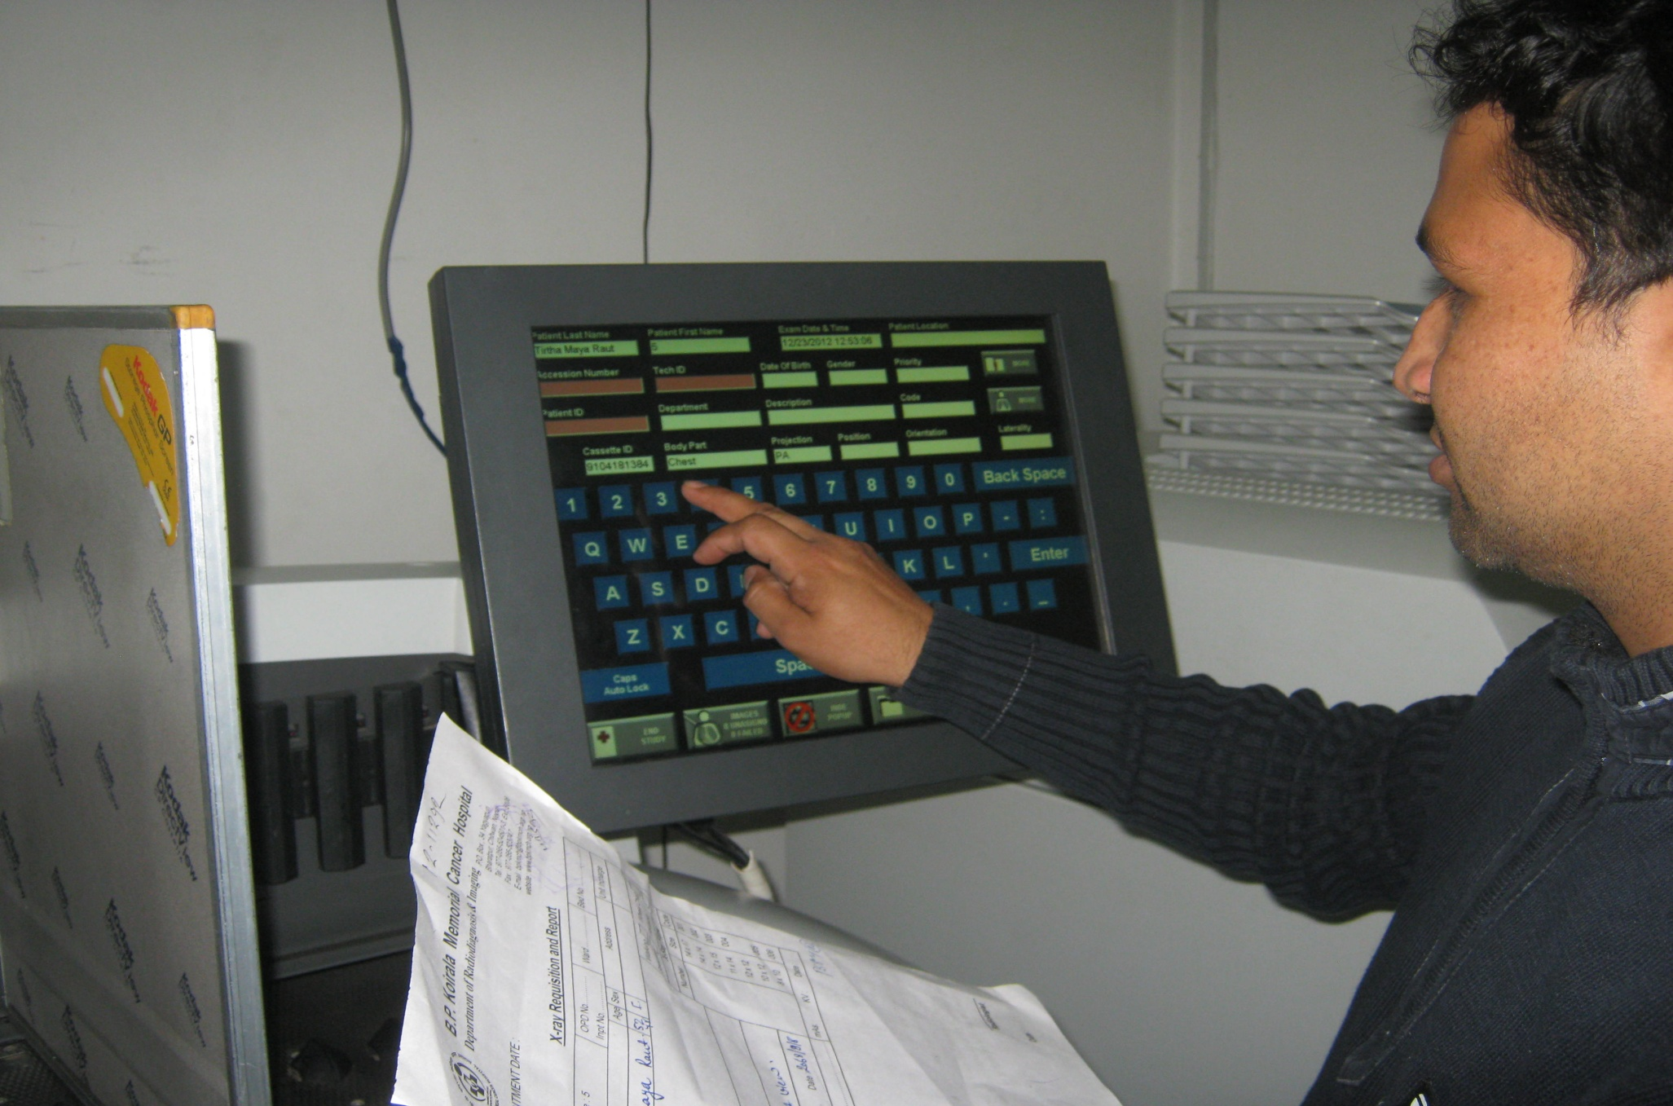
Technologist in Computed radiography

Slide 60
Radiation Protection
&
management of radiation sources

Slide 61
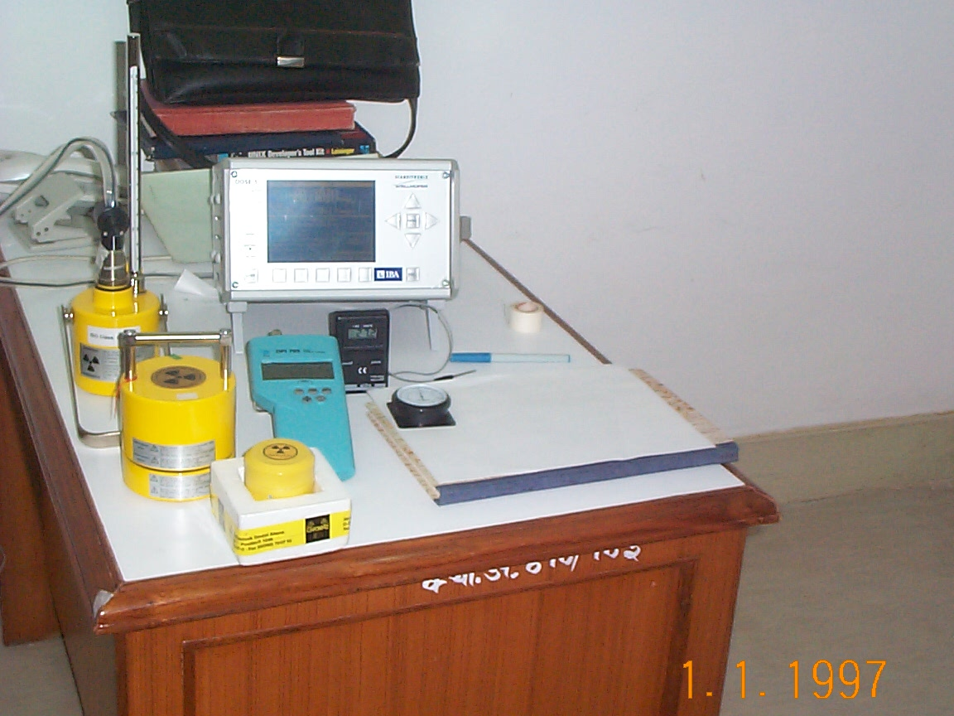
Strontium -90, Cs – 137 check sources for chambers/survey meter calibration @ 10 cm - 1µSv/hr

Slide 62
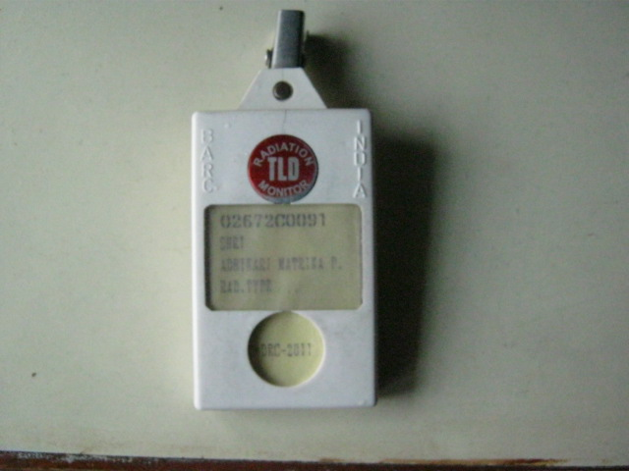
TLD Personnel Monitor

Slide 63
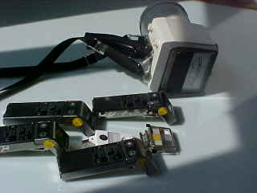
Pocket Dosimeters, TLDs, Film Badge and Survey Meter

Slide 64
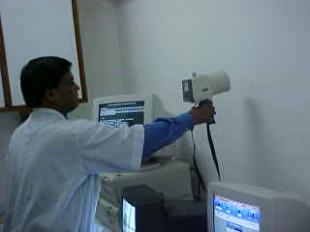
Console Area Wall, Beam On, Gantry 90º, 20 MV

Slide 65
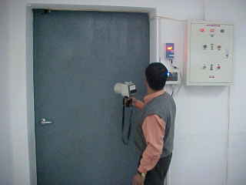
Survey, Brachytherapy, Source Active

Slide 66
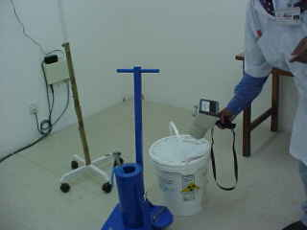
Long Handle Forceps, Shielded Container, Ir-192

Slide 67
Deterministic effects in Diagnostic Radiology
Under extreme conditions,
thresholds for severe deterministic effects have been reached.

Slide 68


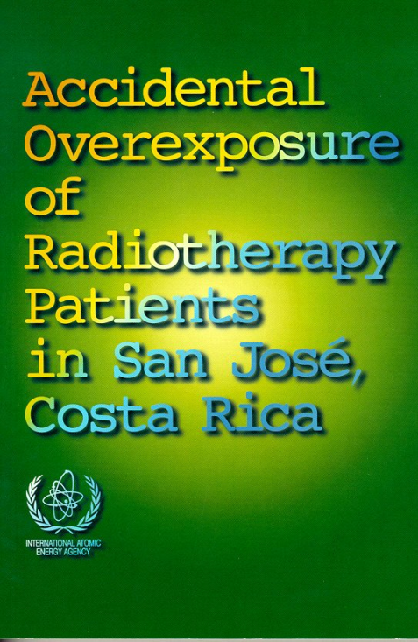
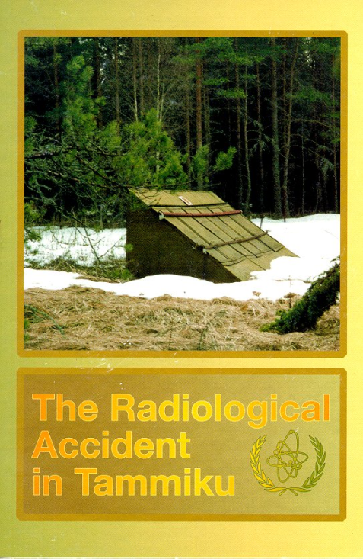
Individual accident reports

Slide 69
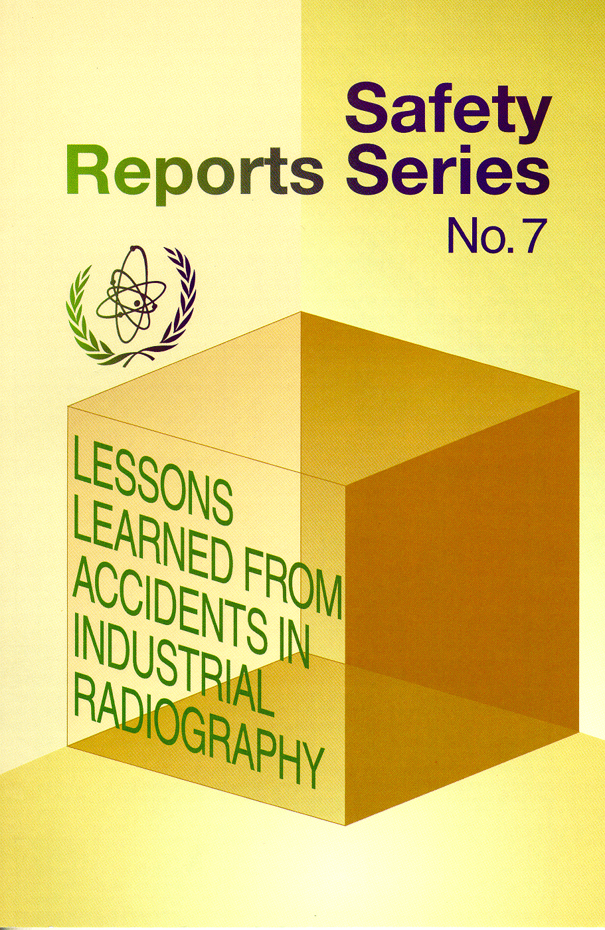
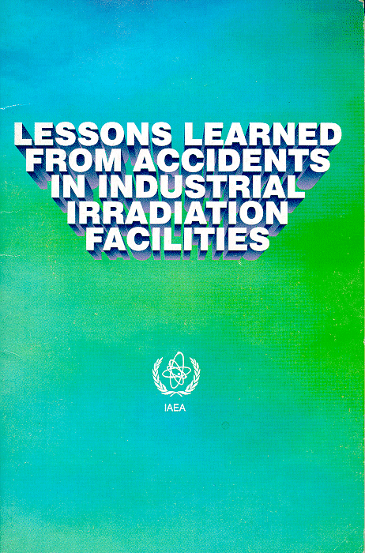

Reports on lessons from major accidents

Slide 70


Management of old source

Slide 71

Disposed site

Slide 72



Accidents with industrial and research irradiators

Slide 73
Academic activities
Biomedical physics as Optional paper in M.Sc. Program in Central department of physics,Birendra Multiple college,Chitwan,and PN campus Pokhara.
Thesis on Biomedical Physics are going on in BP Koiral Memorial Cancer Hospital,Chitwan,Bir Hospital,Bhaktapur cancer Center.
Medical physicist are actively involved as Thesis guide.
B.Sc. Medical Imaging program is going on in Chitwan Medical College we have been working as Faculty in the program.

Slide 74
B.Sc. Medical Imaging program is going on in TU teaching Hospital Medical Physicist are working as faculty in the program.
B.Sc. Medical Imaging program is going on in BPKIHS,Dharan,No Medical Physics faculty are working there.
NAMS,Bir hospital is conducting MD Radiotherapy in collaboration with B P Kiorala Memorial cancer Hospital and Medical Physicist are involved in as Teaching Faculty.

Slide 75

Thank you
.

